Slide 1
Study for Observation CAR 163916849
 | Team Review Criteria - Observations | Presented by
1 | ·Explain how/If the analysis supports the root cause statement | Yamaoka
2 | ·Based upon the root cause, should the severity of the CAR be changed such that it should now be classified as a Finding? If so, fully explain | Yamaoka
3 | ·Explain why/If the evidence in the milestones was sufficient to confirm that the nonconformity was eliminated | Yamaoka

Slide 2
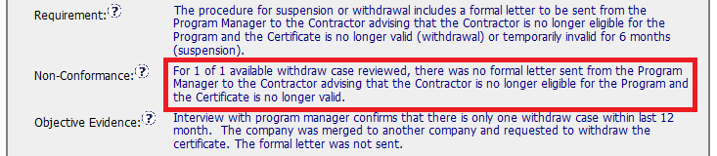
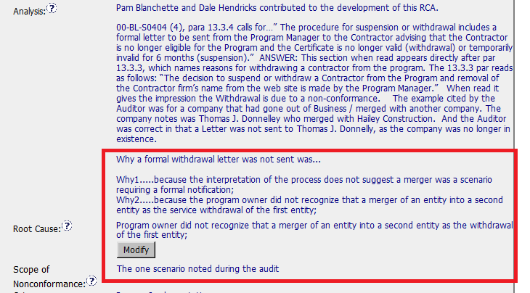
CAR# 163916849 - Background

Slide 3
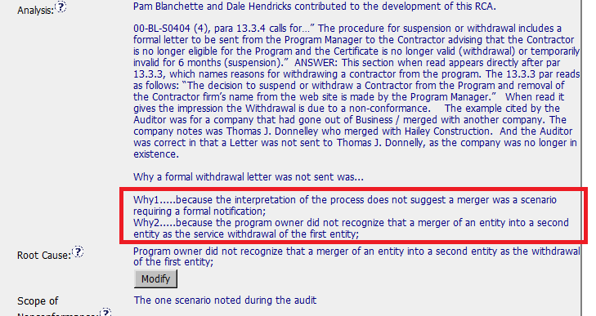
CAR# 163916849
 | Team Review Criteria - Observations
1 | ·Explain how/If the analysis supports the root cause statement
1. Analysis supports the root cause statement because (1) this is a very special case, and (2) interpretation of the process does not suggest it clearly, so that the program owner did not aware of his/her action is necessary.
Notes:
Highlight key points for below criteria:
•Explain how/If the analysis supports the root cause statement

Slide 4
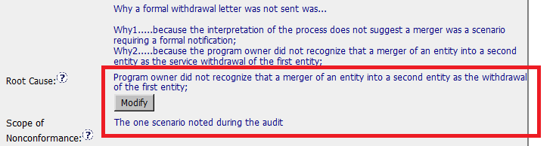
CAR# 163916849
2 | ··Based upon the root cause, should the severity of the CAR be changed such that it should now be classified as a Finding? If so, fully explain
2. No. Because there’s no repeatability of such issue and rareness. This case should be considered as Observation rather than Finding.
Notes:
Highlight key points for below criteria:
·Based upon the root cause, should the severity of the CAR be changed such that it should now be classified as a Finding? If so, fully explain

Slide 5
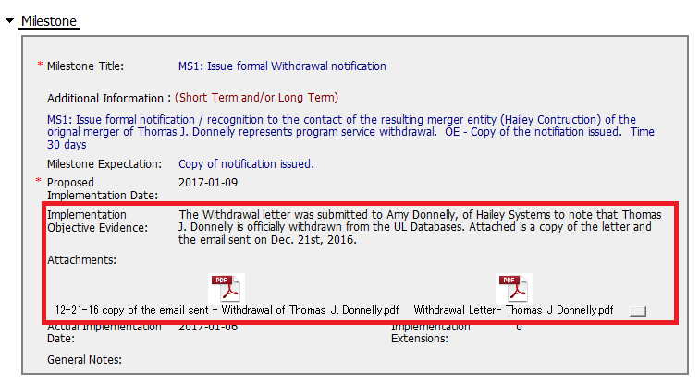
CAR# 163916849
3 | ·Explain why/If the evidence in the milestones was sufficient to confirm that the nonconformity was eliminated
3. This is sufficient because both withdrawal letter itself and the copy of the email have been attached as the evidence.
Notes:
Highlight key points for below criteria:
•Explain why/If the evidence in the milestones was sufficient to confirm that the nonconformity was eliminated

Slide 6
CAR# 163916849 – CAR Review Criteria Check
CAR Review Criteria | Fully | Partially | Not at all | N/A
•Does the analysis support the Scope of Nonconformance statement? | X
•Based upon the root cause, should the severity of the CAR be changed such that it should now be classified as a Finding? |  |  | X
•Was the evidence in the milestones sufficient to confirm that the nonconformity was eliminated?? | X

